Slide 1
Wi-Fi™ Module Product Training
April, 2012

Slide 2

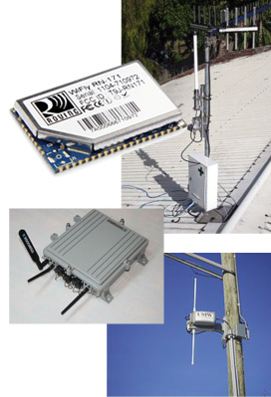
Wi-Fi™ Overview
Protocol
Built on the IEEE 802.11 standard
Conformance testing performed by the non-profit Wi-Fi Alliance (formed in 1999)
Consumer Wi-Fi Growth (2009 - 2010)
158% growth in Wi-Fi enabled consumer electronics
90% cell phones
3 in 4 consumers considered buying a Wi-Fi enabled device
34% laptops
15% Wi-Fi connected 3-D TVs
Embedded Systems
Evangelizes on huge hotspot availability
Provides data with ultra-low cost transport

Slide 3
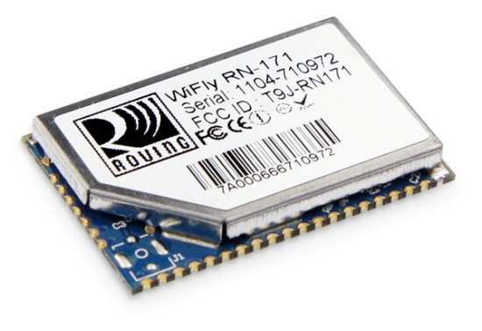
Wi-Fi™ Overview
Roving Networks’ Wi-Fi Solution
Industry’s lowest power, complete system-on-module solution
4-uA sleep
30-mA Rx
Tx variable depending on PA options
Compact surface mount design
Quick & simple to integrate
Complete TCP/IP solution: no external processor or drivers required
Feature Rich, Robust Firmware
Standard build: serial port profile
Extensions: WebScan™ & sensor

Slide 4
Firmware
April, 2012

Slide 5
Roving Networks Firmware
Standard Firmware
Simplifies customer design
No register-level configurations
Manages standard TCP/IP service, e.g., HTTP, DHCP, FTP
Firmware Extensions
Builds on the robust, standard firmware
Provides application-specific extensions
Sensor
Remote provisioning
Automatic sensor data acquisitions
Data logging
WebScan™
RTLS (Real-Time Location System)

Slide 6
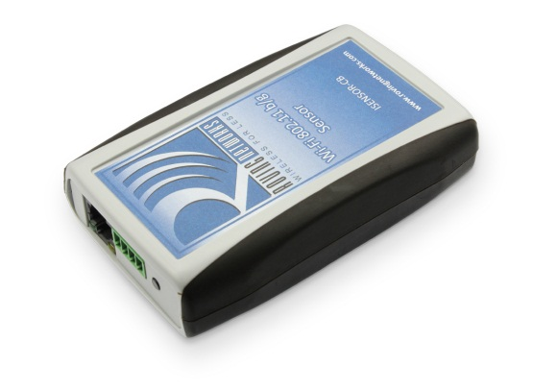
Firmware Extensions
Sensor: Real-Time Monitoring
Uses Roving Networks silicon
Monitors I/O pin & ADC status
Data logger
If module disconnects from access point, it stores data until reconnect when data can be sent to server
Supports remote provisioning
Supports remote software upgrade

Slide 7
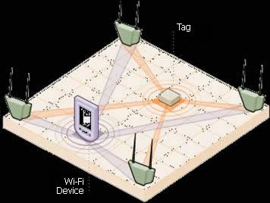
Firmware Extensions
WebScan: Real-Time Location System
Uses Roving Networks silicon
Uses I/O pins, ADCs, RFID & timers for wakeup & data generation
Measures RSSI levels for triangulation
Creates full data packet for server upload

Slide 8
Firmware Extensions
WebScan Example Application
Goods monitored by tag attached to pallet
Pallets arrive at docking bay A
Tag wakes by MAG exciter near docking bay door
Tag probes for access points & measures their RSSI level
Tag sends RSSI data to company’s server via Wi-Fi
Tag reports logged data
Refrigeration truck temperatures
Tag wake up reasons
Battery life

Slide 9
Wi-Fi Lab: Introduction
April, 2012

Slide 10
Lab Agenda
Introducing WiFly
Firmware
Hardware architecture
Capabilities
Hands-On Wi-Fi Labs
Association & UDP
TCP connections & embedded applications
Roaming & FTP
HTML client & sensors
Location tracking (optional)
Ad hoc & further FTP (optional)
Resources

Slide 11

Data & Command Modes
A
B
Data Mode (Default State)
WiFly module like data pipe
TCP/UDP header stripped or added, transparent to UART
Data written to UART is sent out over Wi-Fi
Data received over Wi-Fi is read from UART
Command Mode ($$$)
Special configuration mode entered using $$$
Used to assign data, e.g., SSID, pass phrase, etc.

Slide 12
Command Mode: Configuration Settings
Performed Using ASCII Commands
User Guide
Configuration Settings Stored in Module’s Flash
Changes are persistent & reloaded after power cycling
Changes kept using save command
Many settings require reboot to take effect

Slide 13
Command Mode: Syntax
Commands Use Keyword Followed by Additional Information
Command Rules
Case sensitive
Spaces not allowed, substitute $ “MY NETWORK” = “MY$NETWORK”
Can Use Shorthand
set uart baudrate 115200 valid
set uart b 115200 valid
set u b 115200 valid
s uart baudrate 115200 Invalid

Slide 14
Command Mode: Keywords
Set: Immediate Effect, Permanent If Saved to Configuration File
Get: Retrieve & Display Permanently Stored Information
Status: Current Interface Status, IP Address, etc.
Action: Perform Actions Such As Scan, Connect & Disconnect
File: Upgrade, Load & Save Configuration, Delete Files, etc.
Set Command | Function
AdHoc | Controls the ad hoc parameters
Broadcast | Controls the broadcast hello/heartbeat UDP message
COMM | Communication & data transfer, matching characters
DNS | DNS host & domain
FTP | FTP host address & login information
IP | IP settings
Option | Optional & infrequently used parameters
Sys | System settings such as sleep & wake timers
Time | Real-time clock settings
UART | Serial port settings such as baud rate & parity
WLAN | Wireless interface, such as SSID, channel & security options

Slide 15
Hardware Architecture: Key Features
2.4-GHz IEEE 802.11b/g Tx/Rx
Ultra Low-Power Consumption
4-uA sleep
40-mA RX/connected
200-mA maximum TX
Sparc 32-Bit Micro
Embedded TCP/UDP/IP stacks
Hardware Interfaces
UART: 1-Mbps streaming
SPI slave: 2.7-Mbps streaming
10 GPIO Pins
Status & control
8 Analog Sensor Inputs
14-bit, 35-us frequency
0 to 1.2 V
Security: Hardware Encryption Engine
WEP128
WPA-PSK
WPA2-PSK (TKIP & AES)
Real-Time Clock
1-MB Flash Memory for Data Logging
2-KB NV RAM
Battery Boost Regulator

Slide 16
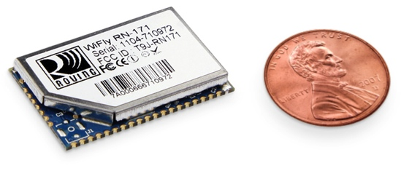
Hardware Architecture: Silicon

Slide 17
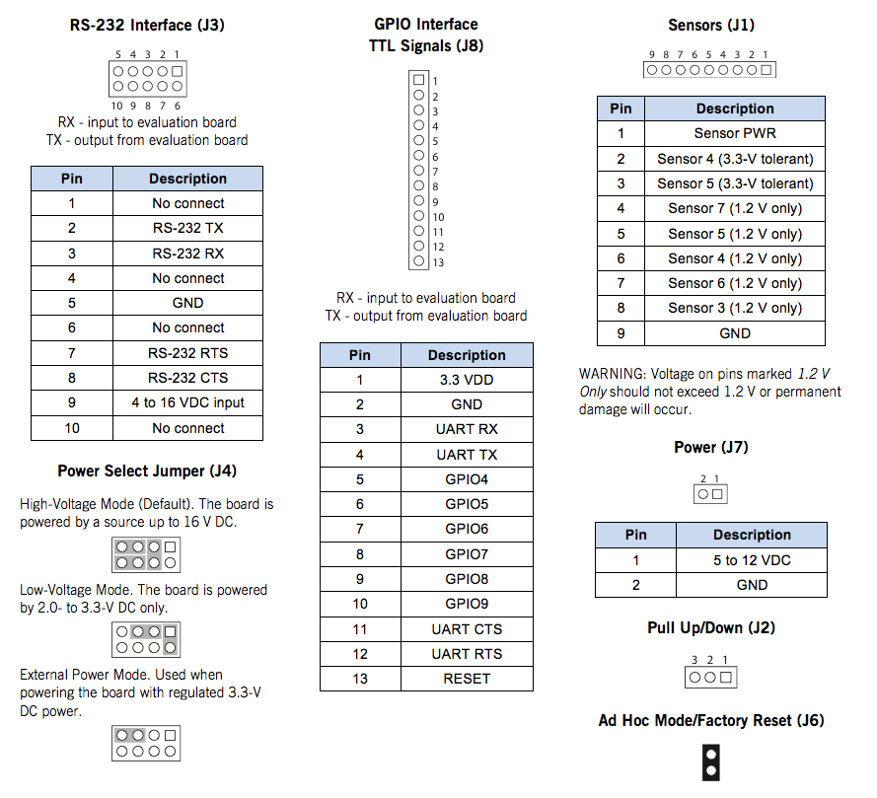
Hardware Architecture: Development Environment

Slide 18
Wi-Fi Lab
April, 2012

Slide 19
Lab Prerequisites
Hardware
RN-134-K or RN-174-K evaluation kit
Configured access point (AP)
Security: WEP-128, WPA-TKIP or WPA2-AES
FTP server to upload & store data
Utility Software
Available from http://www.rovingnetworks.com support page
Tera Term (terminal emulator)
PortPeeker (packet sniffer)

Slide 20
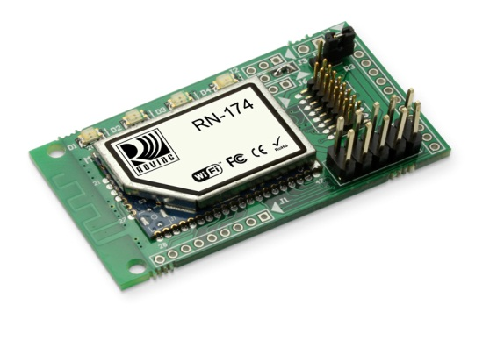
Lab 1: Association & UDP
Lab Overview
Infrastructure & ad hoc networks
Hardware setup
Configuration parameters & factory resets
Scan, join & authenticate
Broadcast UDP
Device name
Sensor mask
UDP auto-pair

Slide 21
Lab 1: Association & UDP
Roving Networks Device
192.168.0.3
192.168.0.1
Access Point
DHCP server
174.201.25.16
Roving Networks Device
192.168.0.2
To Internet
Roving Networks Device
Infrastructure Networking
169.254.1.2
Supported Security Modes
WEP 64, WEP 128 OLD/NOT SECURE
WPA1 TKIP
WPA2 AES has not been compromised
Enterprise not currently supported
Finding Devices on Network
Roving Networks Device
Roving Networks Device
169.254.1.1
169.254.1.3
169.254.1.3
Roving Networks Device
Ad Hoc Networking

Slide 22
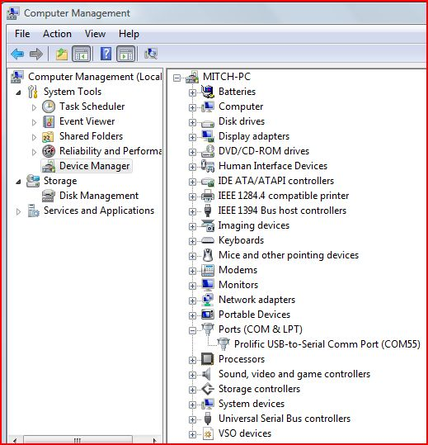
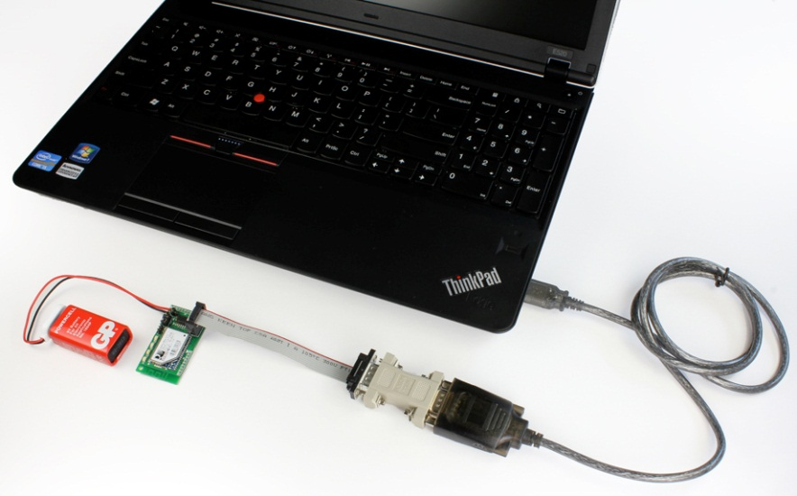
Lab 1: Hardware Setup
Connect Evaluation Board
Connect board to your computer
Connect battery
Blue LED lights up (RN-134-K only)
Green LED blinks slowly
Use device manager to find the COM port

Slide 23
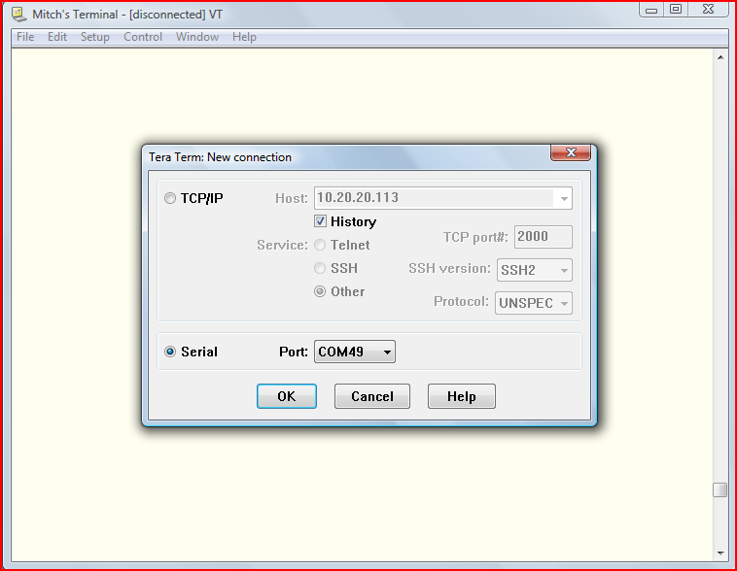
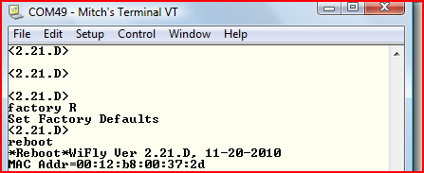
Lab 1: Configure Module via UART
Launch Command Mode
Run Tera Term
Open assigned COM port
Serial port settings: 9600 baud, 8 bits, No Parity, 1 stop bit
Type $$$
Module responds with <CMD>
Review & Reset Configuration
Check configuration & firmware version
get e
ver
Perform factory reset (starts module in known state)
factory R
reboot
Notes:
Write down module’s IP address.

Slide 24
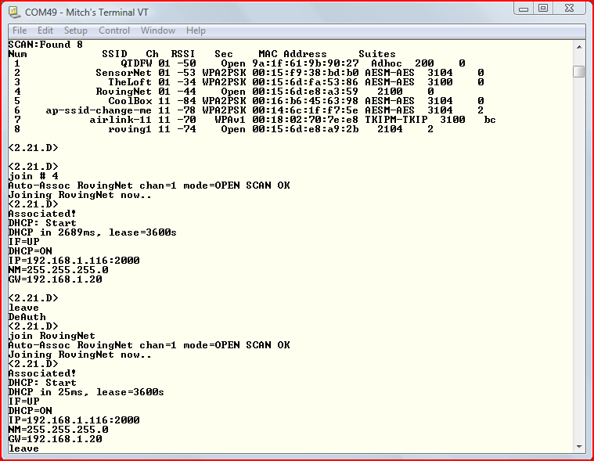
Lab 1: Joining/Associating with Networks
Search for Networks
$$$ (enter command mode)
scan
Join a network
join # 1 (remember spaces)
leave
join <string> (e.g., join RovingNET)
leave
Auto-Join Network with Persistent Configuration
set wlan ssid <string>
set wlan pass <string>
save
reboot
TIP: If Network Is Secure, Set Pass Phrase with set wlan pass <string> before Joining Network

Slide 25
Lab 1: Interim Summary
Configured Module via the UART in Command Mode
Next, Observe Wi-Fi Activity Using PortPeeker

Slide 26
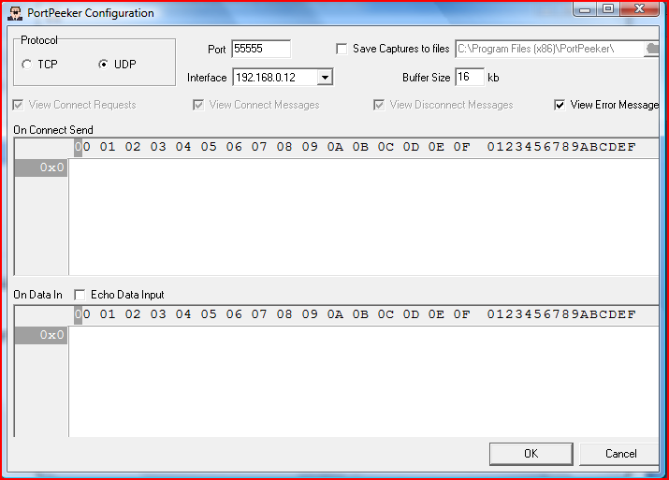
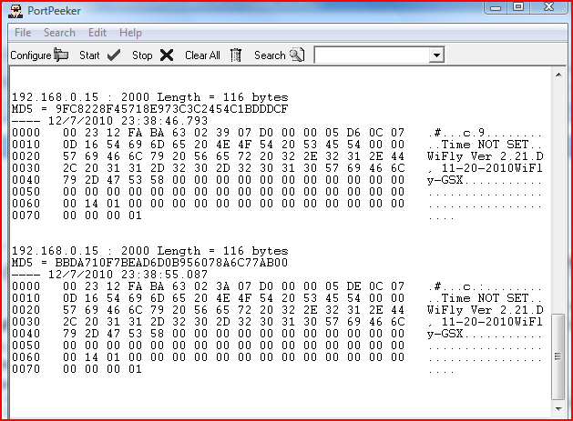
Lab 1: Configure & Capture UDP with PortPeeker
Associate PC with Same AP as Module
Enter command mode & retrieve module’s IP address
Ensure PC is on same subnet
Launch & Configure PortPeeker
Click configure
Set port number to 55555 (default)
Set protocol to UDP
Click OK
Start UDP Packet Capture
Click Start
If PC & module are on same subnet, broadcast packets shown
If multiple nodes on network, look for YOUR IP address

Slide 27
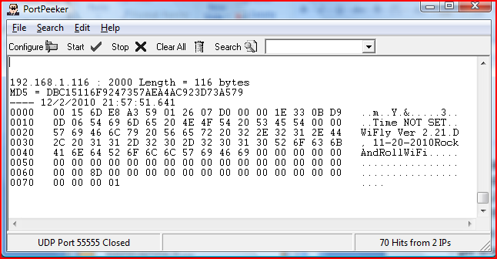
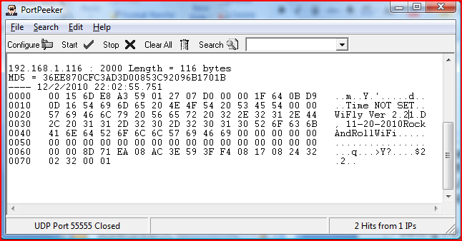
Lab 1: UDP Broadcast
Module Sends UDP Broadcast at Specified Intervals
UDP Broadcast Contains Information that Identifies Module on Network
Set UDP Broadcast Interval
Enter command mode
get broadcast (observe current interval)
set b i 3 (b=broadcast, i=interval)
save & reboot
Review UDP messages in PortPeeker
Enable Sensor Data in UDP Broadcast
Enter command mode
set q s 0xff (set sensor mask)
save to make persistent
Reboot not required
Review UDP messages in PortPeeker
Sensor data highlighted
Notes:
After typing ‘get broadcast’ observe interval in Tera Term
Set b I 3

Slide 28
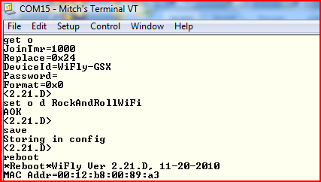
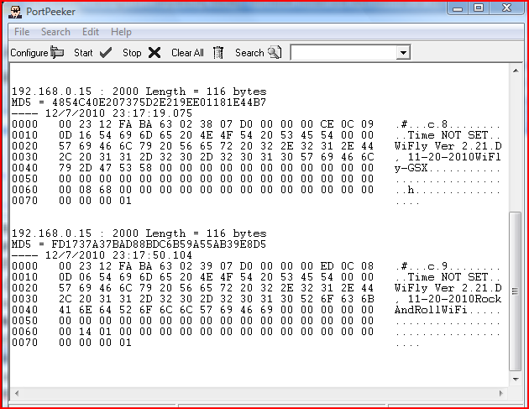
Lab 1: Setting Device Name
Device Names Can Identify Products on Network
Can Append Device ID to UDP Broadcast
Set Device ID
Enter command mode
get option
set o d RockAndRollWiFi (o=optional, d=deviceID)
save & reboot
Review UDP messages in PortPeeker
Set Broadcast UDP Port
Enter command mode
get broadcast
set b p 50000 (b=broadcast, p=port)
Save & reboot not required
Reconfigure PortPeeker to listen for UDP packets on port 50000
Review UDP messages in PortPeeker
TIP: UDP Broadcast on by Default Set Interval to 0 to Turn It Off
Notes:
JoinTmr = time will to wait for AP (WiFi std is 250mS, we set default to 1000mS since DLink is slow)
Replace = 0x24 - this si the alternative character ($)
Remember if someone uses a space then they need to remember to use a replacement character else the latter part of the name will be missing.
See current port number with get broadcast, should be 55555 from earlier. Set b p 50000 will change it. Note PortPeeker will stop seeing the broadcast.
What will happen if you changed the BCAST from 255.255.255.255 to a specific address? – Message is sent to that particular address, not entire subnet.

Slide 29
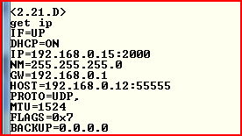
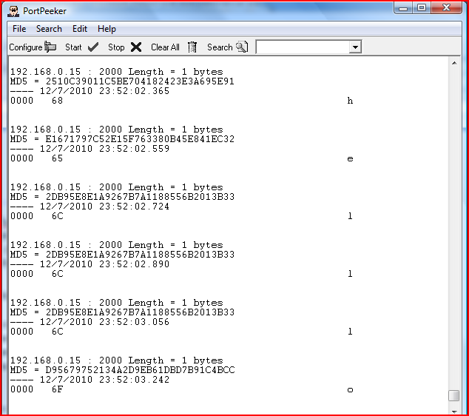
Lab 1: Sending UDP Packets
UDP Mode Not Enabled by Default
Enable UDP by Setting Remote Host, Port & Protocol
Enter command mode
factory R
Associate with AP
set ip host <address>
set ip remote 50000
set ip proto 1 (IP protocol bitmask; 1 = UDP)
set comm timer 1000 (try 10, see the change)
get ip
save & reboot
Type characters; they appear in PortPeeker
TIP: IP Protocol Value Is a Bit Mask You Can Enable Both TCP & UDP Messages

Slide 30
Lab 1: UDP Auto Pairing Mode (Optional Slide)
Similar to Bluetooth Pairing, Module Can Store IP Addresses for Fast UDP Message Setup
Example Requires 2 Modules
Module 1: Clear Host IP & Port & Set Auto Pair Mode
$$$ (enter command mode)
set ip host 0.0.0.0
set ip remote 2000
set ip local 2000
set ip flag 0x40
save & reboot
Module 2: Set Module 1 Host IP & Port
$$$ (enter command mode)
set ip host <module 1 address>
set ip remote 2000
set comm timer 1000
save & reboot
Test System
Type characters in module 2’s terminal; they appear in module 1’s terminal window
Type characters in module 1’s terminal; they appear in module 2’s terminal window
Notes:
Setting ip host to 0.0.0.0 ensure unit doesn’t talk to anyone
The magic comes about because module 1 learns the address when module 2 talks to it.

Slide 31
Lab 1: Conclusion
RN-134-K or RN-174-K with Terminal Emulator & Serial Cable Provides Simple, Effective Development Environment
Joining Networks Is Easy
Use Broadcast UDP to Find Modules on Network Using Device Names & MAC Addresses
Module Sends UART Data as UDP Packets when Associated with Network in UDP Mode

Slide 32
Lab 2: TCP
Objective
Connect from module to remote host using TCP
Connect to module from remote host using TCP
TCP modes
Auto-connect features
Alternative GPIO functions
Event-based TCP packet forwarding
Prerequisites
RN-134-K set up as in Lab 1
Module associated to access point (AP)
Computer associated to same AP
Telnet client (Tera Term)
PortPeeker application

Slide 33
Lab 2: TCP Connections
RN-134-K
Remote Host
Access Point
DHCP server
192.168.1.50
Listen on Port 2000
192.168.1.200
Listen on Port 5000
TCP Connections Are Point to Point
Provide Reliable, Guaranteed, In Order Data Delivery
Also Known As Sockets
open 192.168.1.200 5000
open 192.168.1.50 2000
WiFly Module Opens TCP Connection
Sensing applications
Sending data to web server
Data acquisition systems
Fleet management
Remote Host Opens TCP Connection
Industrial controls
Home automation
Universal remotes

Slide 34
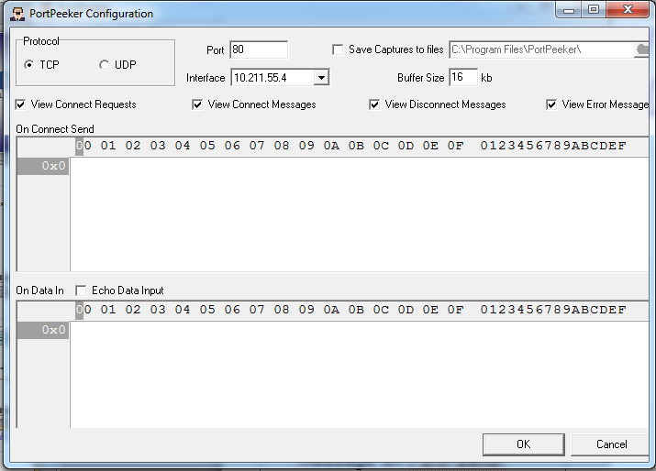
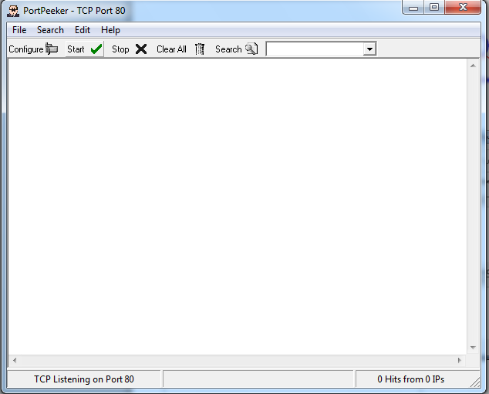
Lab 2: Setup PortPeeker
Associate Computer with AP
Launch PortPeeker
Configure PortPeeker
Click Configure (Note PC’s IP address in Interface box)
Set port to 5000 (port number matches remote port of WiFly module)
Set protocol to TCP
Click Start to Capture TCP Packets

Slide 35
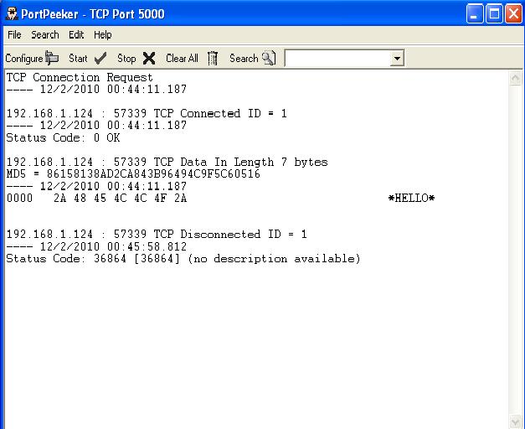
Lab 2: Open TCP Connection from Module
With Module Connected to PC over USB-Serial Cable, Open Tera Term on Serial COM Port
Restore Module to Factory Defaults
Enter command mode
factory R
Associate with AP
save & reboot
Open TCP connection
open <remote host address> 5000
*OPEN* shown on serial port (Tera Term window) & packet with *HELLO* on PortPeeker
Close TCP Connection
Enter command mode
close
Close string *CLOS* displayed in Tera Term

Slide 36
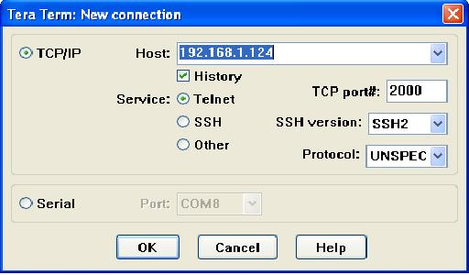
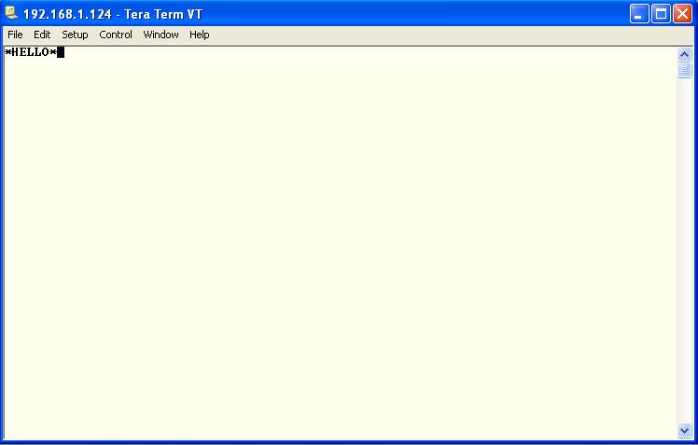
Lab 2: Connecting from Remote Host to WiFly module
In Command Mode, Obtain Module’s IP Address
get ip
Open Telnet Connection from PC Using Tera Term (Use Existing Instance)
Click File > New connection
Select TCP/IP
Select Telnet
In Host field, type module’s IP address
TCP port# is 2000 (default listening port)
Click OK
*HELLO* Message Shown in Telnet Window Indicating Successful TCP Connection
Type in Telnet Window; Data Appears on Serial Port Window & Vice Versa
Can Configure Module Remotely over Telnet by Entering Command Mode
*HELLO*
Notes:
Don’t open a new Tera Term – open a new connection within the existing instance.

Slide 37
Lab 2: TCP modes
Module Supports Three TCP Modes
TCP client & server mode
Default mode initiates & accepts TCP connections
Currently supports one active connection at a time
Concurrent TCP connections supported in future
TCP client ONLY mode
ONLY initiates TCP connections; cannot accept incoming connections
Secure mode
ONLY receives packets from host that matches stored host IP address
TIP: Refer to User Manual for More Details on TCP Modes

Slide 38
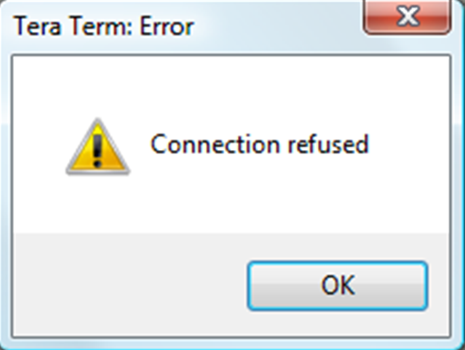
Lab 2: TCP Client Mode
Set Up Module in TCP Client Mode
set ip proto 8
save & reboot
Open New Telnet Connection to Module from Tera Term
Second Connection Is Refused Indicating TCP_Client Mode Works Correctly

Slide 39
Lab 2: Auto-Connect Feature
Module Can Automatically Open TCP Connection to Remote Host on Power Up or Waking from Sleep
Auto-Connect Controlled by autoconn Setting
set sys auto 1 // Attempts to open TCP connection immediately once only
set sys auto <value> // Attempts to open TCP connection every <value> seconds
set sys auto 255 // Attempts to open TCP connection once & go back to sleep immediately // when connection is closed
Auto-Connect Requires Module to Store Remote Host’s IP Address & Port #
set ip host <host IP address>
set ip remote <port>
Once TCP Connection Is Opened, It Can Be Closed in Several Ways
close command
Idle timer
Remote host
Idle Timer Closes TCP Connection after Preset # of Seconds of No Activity (No Tx or Rx) on the TCP Link
set com idle <value> //Closes the TCP connection after <value> seconds of inactivity
Notes:
Nothing will be typed into the module on this slide. This is just an intro.

Slide 40
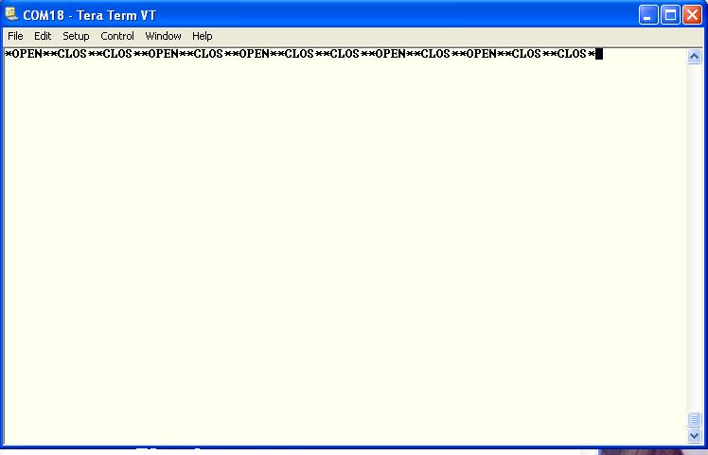
Lab 2: Auto Connect Feature (Timers)
Module Attempts a TCP Connection Every 10 seconds, Drops Connection after 3 seconds Inactivity
set ip host <address>
set ip remote 5000
set sys auto 10
set comm idle 3
save
reboot
PortPeeker: Connection Opens & Closes
Tera Term: Open & Close Strings Shown when Each Connection Opens & Closes
*OPEN**CLOS*…

Slide 41
Lab 2: Alternative GPIO Functions
Firmware Uses GPIO 4, 5 & 6 to Blink Evaluation Board’s Status LEDs (See Section 2.4 in User Manual for Standard LED Function)
Microcontroller Opens or Closes TCP Connection to Stored Remote Host by Driving GPIO5 High or Low
This setup requires a hardware configuration that is not part of this lab
Microcontroller Can Monitor TCP Connection Status by Reading GPIO6
High = Connected
Low = Not Connected
GPIO | Function | Description
4 (GRN) | Output | High once associated, authenticated & has IP address.
5 (RED) | Input | Set high to trigger TCP connection, low to disconnect.
6 (YLW) | Output | High when connected over TCP, low when disconnected.

Slide 42
Lab 2: Alternative GPIO Functions
Enable Alternative Functions
set wlan ssid <string>
set sys iofunc 0x70
save
reboot
Evaluation board LEDs do not turn on
After Module Associates with AP
Associate with AP
save & reboot
Green LED goes on (GPIO4)
Connect/Disconnect TCP Connection
Enter command mode ($$$)
open <address><value>
Red LED blinks & connection closed because RN-134-K board’s GPIO5 pulled to GND
Enter command mode ($$$)
leave // disassociate from AP
Green LED goes OFF

Slide 43
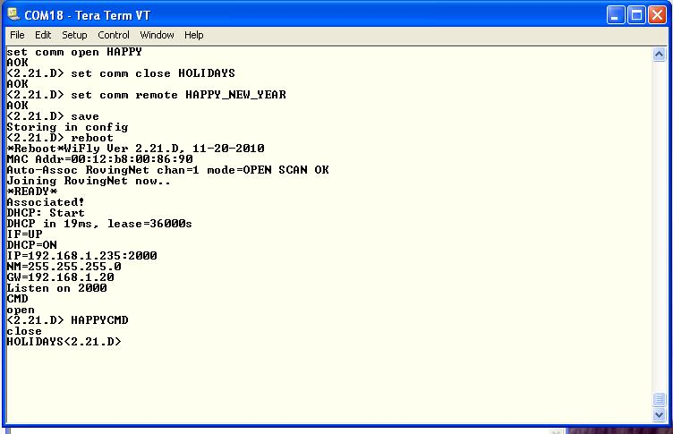
Lab 2: Setting Comm Strings
Microcontroller Can Look for UART comm Strings as Indication of TCP Connection Status
Factory reset
reboot
Associate with AP
set ip host <address>
set ip remote 5000
set comm open HAPPY
set comm close HOLIDAYS
set comm remote HAPPY_NEW_YEAR
save & reboot
Enter command mode
open
See open string in Tera Term
See remote string in PortPeeker
Enter command mode
close
See close string in Tera Term
Tip: Microcontroller Can Read UART Open & Close Strings to Determine TCP Connection Status

Slide 44
Lab 2: Forwarding TCP packets
When Data Is Written to Module’s UART, TCP Packets Forwarded Based On
Flush timer
Flush size
Match character
TCP Packet Sent When Any of These Events Occur
Parameters Logically ORed to Determine when TCP Packet Is Sent
When Configured Correctly, Module Can Be Optimized for Low Latency or High Throughput
Low latency: use lower flush timer value & flush size
High throughput: use higher flush timer value & flush size
Tip: Module Tries to Optimize Automatically for Bandwidth by Increasing Default Flush Size with Higher Baud Rates

Slide 45
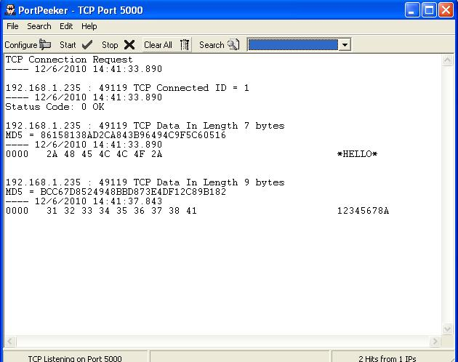
Lab 2: Forwarding TCP packets
Forwarding Packets Based on Flush Timer
set comm timer 1000
save
open
Type text after TCP connection opens
After you stop typing, TCP packet is sent 1 second later
Forward Packets Based on Match Character
set c t 0 (why do we send this command ?)
set comm match 65
This parameter expects ASCII decimal character or HEX value of the match character (e.g., 65= Capital A)
save
open
Type 12345678A
TCP packet sent out after you type A character
Observe packet in PortPeeker
What Do You Learn from Using ‘get c’ Command?

Slide 46
Lab 2: Conclusion
Module Can Open TCP Connection to Remote Host & Accept Incoming Connections from Remote Host
Auto-Connect Automatically Opens TCP Connection
Idle Timer Can Automatically Close TCP Connection
Alternative GPIO Functions Allow Microcontroller to Control & Monitor TCP Connections
comm open, close & remote Strings Can Indicate TCP Connection Status
TCP Packets Forwarded Based On
Packet size
Match character
Flush timer

Slide 47
Lab 3: Association/Roaming & FTP
Objective
Wake & sleep timers
Auto join
Roaming configuration (Linkmon/IP flags)
FTP
Prerequisites
User has completed Labs 1 & 2
Evaluation board & computer set up as described in Lab 1

Slide 48
Lab 3: Where in the World Wide Web are you?
www.google.com
Roving Networks Device
192.168.0.1
192.168.0.2
Access Point
SSID RovingNet
DHCP server
10.10.10.3
74.125.19.103
DNS server
10.10.10.2
Internet
Worldwide Web
Access Point
SSID RovingNet1
Bridge
101.11.2.15
10.10.10.3
Intranet
Local Network
Router
DHCP server
Gateway
To internet
10.10.10.4
135.201.25.15
10.10.10.1
Roving Networks Device
Module Associates with AP Based on SSID
Password required depending on security
Multiple security modes
Multiple AP with same SSID and/or password
Each Wi-Fi Device Must Have Unique IP Address
Provided by DHCP server
Gateway bridges multiple networks, typically Internet with Intranet
Dynamic Name Service (DNS)
Maps URL (www.google.com) to an IP Address 74.125.19.103

Slide 49
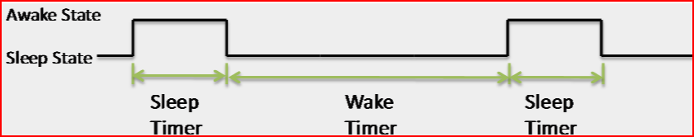
Lab 3: Wake & Sleep Timers
Several Options to Wake Module
FORCE WAKE Signal
Sensors
Internal Timers
Restore Factory Default Parameters & Training AP
Enter command mode
factory R
Associate module with AP
save & reboot
Set Wake Timer: # Seconds in Deep Sleep before Wake Up
set sys wake 10
Set Sleep Timer: # Seconds before Entering Deep Sleep
set sys sleep 5
save & reboot
LEDs cycle on & off (except blue),
Observe module reboot on wake up in Tera Term
TIP: Do Not Set Sleep Timer to Less than 2 Seconds or It Is Hard to Go into Command Mode & Reconfigure Module before It Sleeps Again

Slide 50
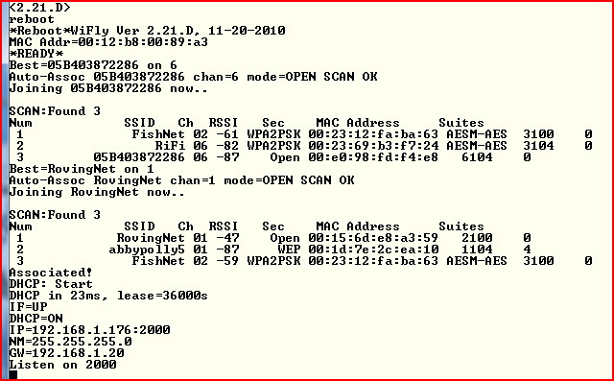
Lab 3: Join Modes
Useful for Module to Associate with Network Automatically
Association Controlled with join Command or join Parameter Setting
Turn Off Auto-Join & Join Manually
Enter command mode
factory R & reboot
Associate module with AP
set wlan join 0
save & reboot
Enter command mode
Join
Modules associates with AP
Auto-Associate with Any Open-Security AP
set wlan ssid <string>
set wlan join 2
set wlan auth 0
save & reboot
Module attempts to join any open network (no security)
TIP: If Network is Secure, Set Pass Phrase with “set wlan pass <password>” before Joining Network
Value | Policy
0 | Manual. Do not join automatically.
1 | Attempt to join the AP that matches the stored SSID, pass phrase & channel. Channel can be set to 0 for scanning. (Default)
2 | Join any AP with security matching the stored authentication mode. This setting ignores the stored SSID and searches for the AP with the strongest signal. The channels searched can be limited by setting the channel mas.
3 | Reserved. Do not use.
4 | Create an ad hoc network using the stored SSID, IP address & netmask. You must set the channel.

Slide 51

Lab 3: Roaming (Optional Slide)
Module Wakes, Searches for Aps, Connects, Off Loads Data & Returns to Sleep
Used for Asset Tracking, Fleet Management & Remote Sensor Applications
Combine Broadcast UDP, Wake Timers & Auto Join
Enter command mode
factory R & reboot
set broad interval 3
set opt device <string>
set wlan join 2
set wlan auth 0
set sys sleep 15
set sys wake 5
save & reboot
Open PortPeeker to Receive UDP Broadcast Messages (Lab 1)
Confirm Module’s UDP Broadcast Message
Move Module Near AP_SSID1 AP
Move Module Near AP_SSID2 AP
PortPeeker shows AP MAC address in broadcast UDP message change

Slide 52
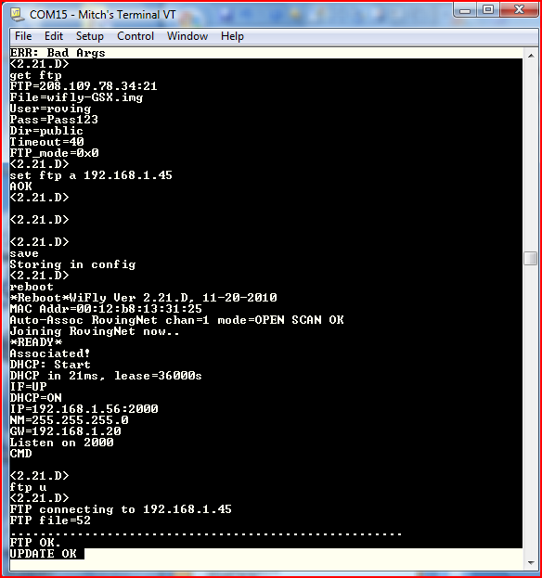
Lab 3: FTP Update (REQUIRES Internet Access)
Use Module’s FTP Client to Update Firmware & Put/Get Data
Default Username/Password Set to Roving Networks’ FTP Server
Associate to Internet-Connected Network & Use “ftp update” Command
Use Local FTP Server
Enter command mode
factory R
Associate module with AP
save & reboot
Update Firmware
Enter command mode
ftp update
ver
reboot
Enter command mode
Ver
TIP: After Downloading New Firmware, Restore Module to Factory Defaults Before Using It

Slide 53
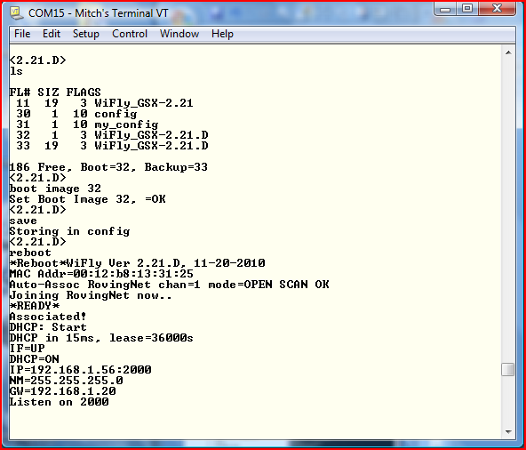
Lab 3: Setting Firmware Boot Image
Firmware Stored in Embedded Flash Memory
Boot Image is Firmware Version Module Is Currently Running
After Successful Update, Boot Image Changes to New Firmware File
Change Boot Image
Enter command mode
View Files in Flash
Enter command mode
ls
Change Boot Image
Enter command mode
boot image <value>
reboot

Slide 54
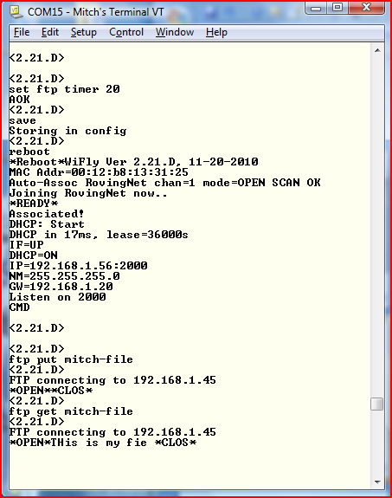
Lab 3: FTP put & get
FTP Client Can Stream Files to/from FTP Server
Useful in data logger applications
FTP Servers Can Accept Multiple Clients Concurrently
Configure FTP Setup
Enter command mode
factory R & reboot
Associate module with AP
set ftp address <address> (e.g., ftp svr addr)
set ftp user <string> (e.g., roving)
set ftp pass <string> (e.g., Pass123)
set ftp dir <string> (e.g., public)
set ftp timer 20
save & reboot
Create & Read File on Server
Enter command mode
ftp put <string>
Type characters, wait until *CLOS* shown
ftp get <string>

Slide 55
Lab 3: Conclusion
Sleep & Wake Timers Allow Module to Deep Sleep to Save Power & Periodically Connect to Network
Roaming Allows Module to Connect to AP with Strongest Signal that Matches SSID or Authentication Mode
Use FTP to Update Firmware
Use FTP put & get Commands to Transfer Files
FTP put Combined with Sleep/Wake/Roaming Useful for Data Logging Applications

Slide 56
Lab 4: HTTP Client
Objective
Post data to web server
Uses built-in feature
Does not require external processor
Configure HTTP client mode
Periodically send sensor data web server
Wake on UART data
Prerequisites
Hardware same as in previous labs
Module associated to Access Point (AP) with Internet connectivity
Tera Term running on PC
Web server configured to accept HTTP messages (Roving Networks Website)

Slide 57
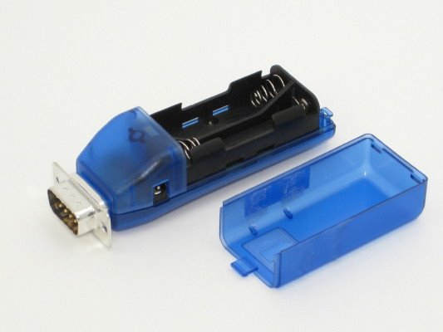
Lab 4: Solutions Architecture

Slide 58
Lab 4: Enabling HTTP Client Mode
HTTP Client Mode Disabled by Default
To enable use set ip proto 18 command
Module Connects to Web Server Using the IP Address or URL
Web Server Listens on Port 80 (Default) for Incoming Connections
For Each Request
Web server responds with 200 OK
Closes the connection

Slide 59
Lab 4: Auto-Posting Sensor Data
In HTTP Client Mode, Module Sends Request Message
GET /server.php?value=0F3000001111222233334444555566667777\n\n
Request message includes comm remote string & sensor readings
Configure HTTP Client Mode & Request Message
Go into command mode
Associate the module with AP
set ip proto 18 // Enable HTTP & TCP protocols
set ip host 0 // Set IP address if known
set dns name www.rovingnetworks.com // Set DNS name if not
set ip remote 80 // Standard web server port
set comm remote GET$/server3.php?value= // $ is replaced by space character
set q sensor 0xff // Sample all sensors inputs
set option format 7 // Send header & sample sensor data
save & reboot
Enter command mode
open
Format
2 Bytes GPIO | Chan 0 | Chan 1 | Chan 2 | Chan 3 | Chan 4 | Chan 5 | Chan 6 | Chan 7
0F30 | 0000 | 1111 | 2222 | 3333 | 4444 | 5555 | 6666 | 7777

Slide 60
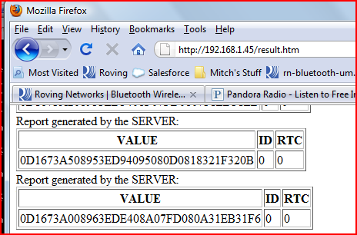
Lab 4: Web Server
*OPEN*HTTP/1.1 200 OK
Date: Fri, 19 Nov 2010 19:24:07 GMT
Server: Apache
X-Powered-By: PHP/5.2.13
Connection: close
Content-Type: text/html
Server accepted values <br />
ID: 0<br />
VALUE: 0D16CF2907ED3EB640AB07E607F4321C3219
RTC: 0
*CLOS* GPIO values Sensor Data
Open Web Browser
The PC must be associated with your AP connected to the internet
In Address Bar, Type www.rovingnetworks.com/result.htm
Scroll to bottom of log to see data
All module data looks the same

Slide 61
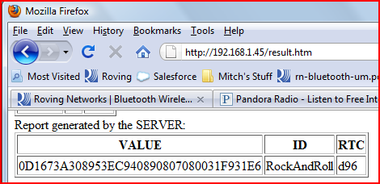
Lab 4: Add Device Name & RTC to Sensor Data
Append Device ID & RTC Value to Sensor Data so Server Can Identify It
Device String: Appends &id=<value>, where <value> is device ID string set with set opt device <string> command
Real-Time Clock: Appends &rtc=<time>, where <time> is real-time clock value in message as 32-bit HEX value in format aabbccddeeff
Turn Off Auto Connect
Go into command mode
Set sys auto 0
Save & reboot
Append Device Name & RTC
Go into command mode
set option device <string>
time // Get network time
set option format 31
save & reboot
Post Data
Go into command mode
open
Tera Term Output
*OPEN*SEND-WEBPOST
HTTP/1.1 200 OK
Date: Mon, 06 Dec 2010 17:56:28 GMT
Server: Apache
X-Powered-By: PHP/5.2.13
Connection: close
Content-Type: text/html
Server accepted values <br /> Device ID
ID: servertest<br />
VALUE: 0D16CF2908043E854020080108043236323A
RTC: 3ad82
*CLOS* Real Time Clock

Slide 62
Lab 4: Auto-Posting UART Data
Module Can Wake on Receiving UART Data, Associate with AP & Send Request Message Containing the UART Data
factory R & reboot
Associate module to AP
set ip proto 18 // set HTTP client mode
set ip host 0 // IP address of web server
set dns name www.rovingnetworks.com // OR DNS name
set ip remote 80 // Web server port
set comm remote GET$/server3.php?value= // Set request message header
set uart mode 2 // Automatically connect using trigger mode
set sys trigger 1 // Wake up on uart RX data
set sys sleep 10 // Put WiFly module to sleep after 10 seconds
set option format 1 // Sends out HTTP header
set comm timer 2500 // Allows multiple keystrokes per request
save & reboot
In Tera Term, Type Characters to Wake Module, Associate to AP & Send Data as HTTP Message to Web Server
NOTE: You Cannot Send both Sensor & UART Data in Same Request Message

Slide 63
Lab 4: Auto-Posting Serial Data
When Serial UART Data Arrives, Module Auto-Connects to Web Server & Sends
GET /server3.php?value=<user’s serial data> \n\n
OPEN*SEND-WEBPOST HTTP/1.1 200 OK Date: Mon, 06 Dec 2010 18:25:36 GMT Server: Apache X-Powered-By: PHP/5.2.13 Connection: close Content-Type: text/html
Server accepted values <br />
ID: 0<br /> VALUE: oving Data with first byte missing RTC: 0 *CLOS*
NOTE: First Data Byte Dropped because Module Must Initialize before Sending Data over Wireless Interface
To Avoid This Issue, Module Should Wake on CTS Signal Using set sys trigger 2 or Send First Byte Twice

Slide 64
Lab 4: Conclusion
Module Supports HTTP Client Mode Natively
When Configured, Module Can Append
GPIO values
Sensor data
Real-time clock
Device name
UART data
Module Can Wake Up on UART Data
May result in dropping first byte
Waking up on CTS is better option

Slide 65
Lab 5: Access Point Mode
Advantages
Enables Android devices to talk to modules without infrastructure
Runs DHCP server
Supports up to 10 clients
Supports routing between clients
Supports WPA2-AES personal security

Slide 66
Lab 5: Creating a Default AP Network
Download Firmware Supporting AP Mode via FTP
RN-131: ftp update wifly-241.img
RN-171: ftp update wifly7-241.img
RN-370: ftp update wiflyA-241.img
Install Jumper at J6 to Enable AP Mode in Hardware
SSID: WiFlyAP-XX, where XX is last two bytes of MAC address
Channel: 1
DHCP server: Enabled
IP address: 1.2.3.4
Netmask: 255.25.5255.0
Gateway: 1.2.3.4

Slide 67
Lab 5: Create Custom AP Network in Software
Create Custom AP Network with User-Defined Settings
set wlan join 7 // Create AP mode network
set wlan channel <value> // Specify channel to create // network
set wlan ssid <string> // Set up network SSID
set ip dhcp 4 // Enable DHCP server
set ip address <address> // Specify IP address
set ip net <address> // Specify subnetmask
set ip gateway <address> // Spcify gateway
save // Store settings
reboot // Reboot module in AP mode

Slide 68
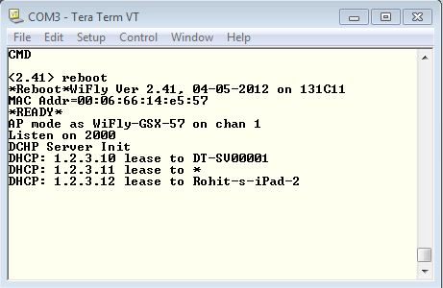
Lab 5: Connect to AP Network Created by Module
From PC/Mobile Phone/Tablet, Connect to Module-Created Network
Module Displays Client’s Device Name

Slide 69
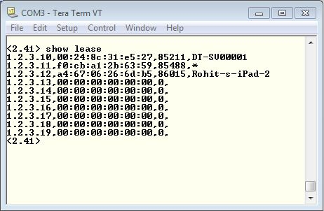
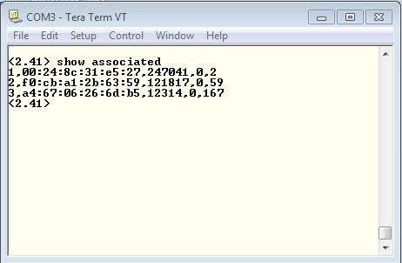
Lab 5: View Associated Devices & Lease Times
View Device Lease Times
show lease
View List of Connected Devices
show associated

Slide 70
Wi-Fi Training Session
Questions

